Slide 1
YouTube Around the World : Geographic Popularity of Videos
Date : 2012/9/2
Resource : WWW’12
Advisor : Dr. Jia-Ling Koh
Speaker : I-Chih Chiu

Slide 2
Outline
Introduction
Methodology
Locality of interest
Social Factors
Temporal Evolution
Conclusion

Slide 3
Introduction
One of the most popular user activities on the Web is watching videos.
With more than 3 billion videos viewed everyday and having more than 70% of its traffic coming from outside the US.
Video popularity on YouTube exhibits a “long-tail” behavior.
Notes:
1.影片的存取會受到地區性的影響，再加上YouTube有個機制會防止相同的影片上傳，因此很難讓每部影片都散佈到全球各地
2.所以
3.少部分的影片卻累積非常多的觀看次數，而大部分的影片觀看次數卻很少

Slide 4
Motivation
How video popularity relates to the global reach of a video
Whether unpopular videos still enjoy high popularity in a certain geographic area
Notes:
1.動機: 去觀察影片的普遍性和一部遍及全球範圍的影片有何關係
看較不普及的影片在某些地區是否能有受到歡迎

Slide 5
Goal
Geographic locality of interest
Geographic relevance
A powerful factor impacts video popularity
Geographic proximity
word-of-mouth
Language and culture
Approach
How to measure and understand it.
View focus
View entropy
Notes:
Geographic relevance 是影響video popularity的關鍵因素之一，探討地區與地區之間的關係
Geographic proximity 透過user來觀察，因為有些影片會透過朋友之間的口耳相傳而造成較高的點擊率，但卻會因為語言和文化的關係而被侷限於某些區域

Slide 6
Outline
Introduction
Methodology
Locality of interest
Social Factors
Temporal Evolution
Conclusion

Slide 7
Data description
Randomly selected from more than 20 million YouTube videos between September 2010 and August 2011
There are about 250 different such regions
Classify these referrer sources
Social
Non-social
Notes:
1.防止因為季節關係而影響到user的行為
2. including official states and minor territories.
3.因為一部影片會經由不同管道來觀看
→例如經由FB (不是YouTube的網站) 點選看到的影片，或是直接點選朋友給予的網址
→主要經由網頁搜尋，或是YouTube內部找尋

Slide 8
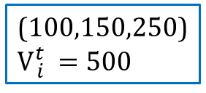
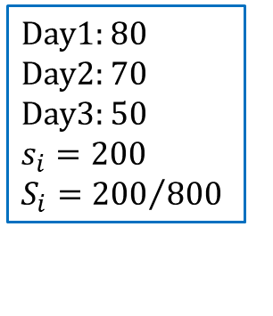

Notation
Given a video i The distribution of its views on day t M different regions $\left(r_{1},…,r_{M}\right)$
Vector : $\left(v{}_{i1}^{t}{,v{}_{i2}^{t},}…,v{}_{iM}^{t} \right)$ V${}_{i}^{t}=\sum_{k=1}^{M}{v{}_{ik}^{t} }$
Video i in region $r_{k}$
$v_{ik}=\sum_{t≥t_{i}}{v{}_{ik}^{t} }$ $V_{i}=\sum_{k=1}^{M}{v_{ik}}$
Define s${}_{i}^{t}$ as the number of views received from social referrers by video i on day t
$s_{i}=\sum_{t≥t_{i}}{s{}_{i}^{t} }$ $S_{i}=\frac{s_{i}}{V_{i}}$ (where S${}_{i}^{t} =\frac{s{}_{i}^{t} }{V{}_{i}^{t} }$)
(100,150,250)
V${}_{i}^{t} =500$
Day1:(50,100,80)
Day2:(100,70,170)
Day3:(60,50,120)
(210,220,370)
V${}_{i}^{} =800$
Day1: 80
Day2: 70
Day3: 50
$$s_{i}=200$$
$$S_{i}={200}/{800}$$

Slide 9
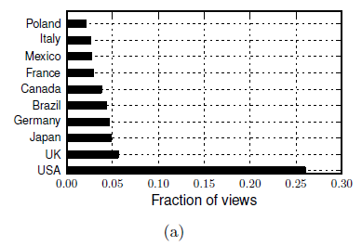
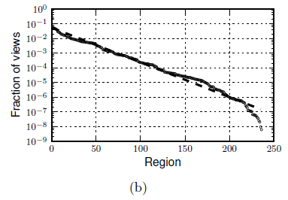
Methodology
Analyzing how YouTube views are distributed across the world confirms that the majority of YouTube traffic does not come from the USA
26%
Notes:
主要的流量並非都是從美國來的 only 26% of YouTube views are generated in the USA 其餘有74%的流量是來自於其他國家

Slide 10
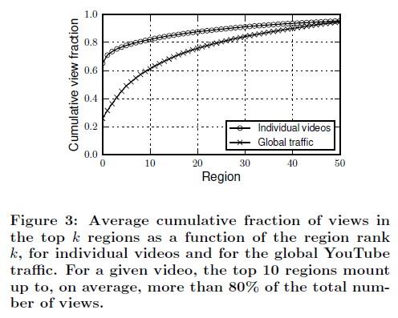
Methodology
On average YouTube videos acquire a large fraction of their views from only a very small number of regions

Slide 11

Locality measures
In order to quantitatively study whether a YouTube video receives views from a global rather than from a local audience
View focus : $F_{i}=\frac{1}{V_{i}}\max_{k}{v_{ik}}$
Video1:(100,150,150) $F_{1}=0.375$
Video2:(25,25,200) $F_{2}=0.8$
Video3:(100,100,100) $F_{3}=0.33$
View entropy : $H_{i}=−\sum_{k=1}^{M}{\frac{v_{ik}}{V_{i}}\log_{2}{\frac{v_{ik}}{V_{i}}}}$
Video1:(100,150,150) $H_{1}=1.561$
Video2:(25,25,200) $H_{2}=0.922$
Video3:(100,100,100) $H_{3}=1.585$

Slide 12
Outline
Introduction
Methodology
Locality of interest
Social Factors
Temporal Evolution
Conclusion

Slide 13
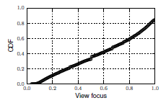
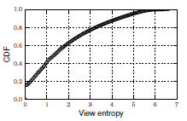
Measuring locality of interest

Slide 14
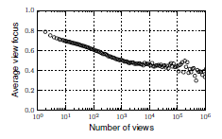
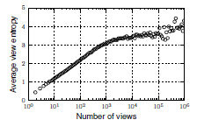
Measuring locality of interest
Notes:
(左圖)This is still higher than one would expect by observing the distribution of global YouTube traffic in Figure 2: in fact, no region exhibits more than 26% of the overall number of views.
(右圖) view entropy values reach a plateau at about 3.5 bits.

Slide 15
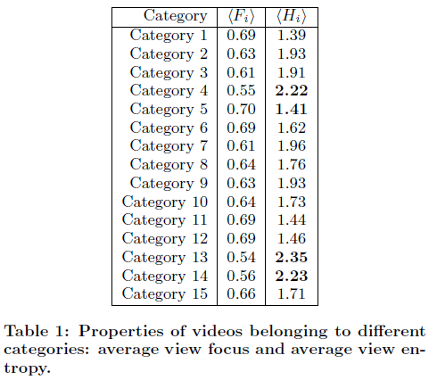
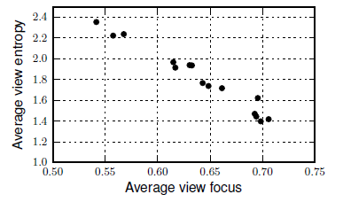
Impact of video category

Slide 16
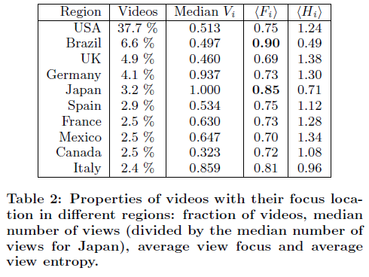
Impact of video location

Slide 17
Outline
Introduction
Methodology
Locality of interest
Social Factors
Temporal Evolution
Conclusion
Notes:
由於朋友之間會互相傳遞感興趣的影片

Slide 18
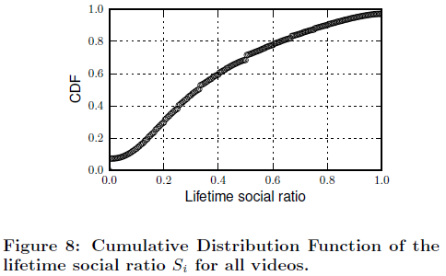
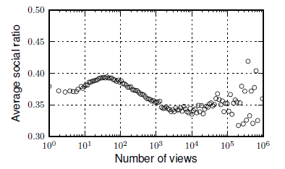
Social ratio
Social or non-social
50
Average value : 0.37

Slide 19
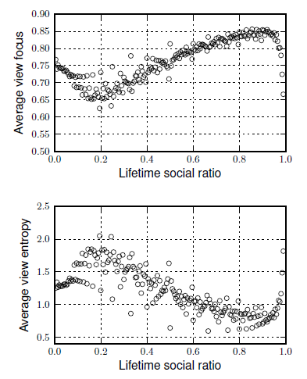
Impact of social sharing
To understand whether higher levels of social sharing results in a more local, or global,

Slide 20
Outline
Introduction
Methodology
Locality of interest
Social Factors
Temporal Evolution
Conclusion
Notes:
分析時間與view focus和view entropy之間的影響 因為有些影片的觀看次數相當的少，無法提供足夠的資訊
所以在這裡只考慮觀看過100次以上的影片

Slide 21
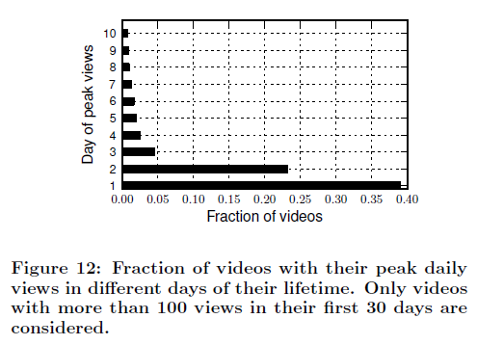
Video views growth
Particularly before and after the peak, can be used to classify popular videos.

Slide 22
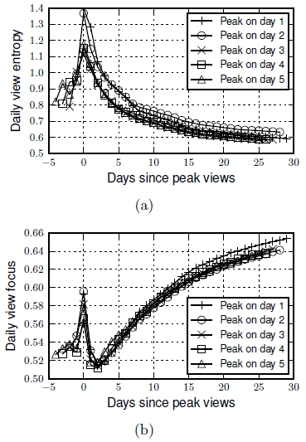
Evolution of local interest
To understand whether videos show a similar behavior when their daily number of views peaks.

Slide 23
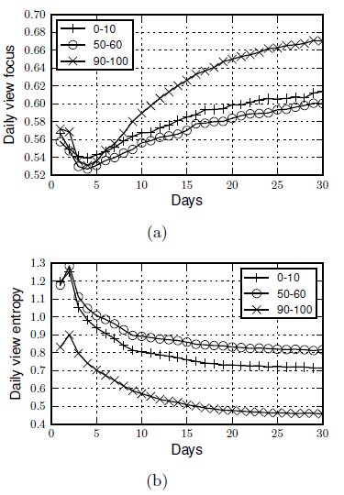
Effect of social sharing
Analyze the impact of social sharing on the temporal evolution of the spatial properties.

Slide 24
Outline
Introduction
Methodology
Locality of interest
Social Factors
Temporal Evolution
Conclusion

Slide 25
Conclusion
Used new measures to quantify their popularity distribution across different geographic regions and discussed the impact that video properties have on these measures.
Predictive and classification models for video popularity could take spatial properties into account to refine their performance.
search and recommendation engines may exploit these spatial measures to tailor their results and adapt them to the user's geographic location.

